Slide 1

Employee Data Analysis using Excel
STUDENT NAME: DHISHIKA . K
REGISTERNO : 5181B1B062E0461BF234119CD69C3,122201814 DEPARTMENT : B.COM(CORPORATE SECRETARYSHIP )
COLLEGE : MEENAKSHI COLLEGE FOR WOMEN

Slide 2
PROJECT TITLE
EMPLOYEE PERFORMANCE BASED ON GENDER AND EMPLOYEE RATING

Slide 3



AGENDA
1.Problem Statement 2.Project Overview 3.End Users
4.Our Solution and
Proposition 5.Dataset Description 6.Modelling Approach
Results and Discussion
Conclusion
3/21/2024 Annual Review

Slide 4


PROBLEM STATEMENT
To identify whether there are any disparities in performance evaluations and ratings between male and female employees, and to explore how these ratings correlate with actual performance metrics. This analysis seeks to determine if gender biases exist in performance evaluations for promoting fairness and equity in the workplaces.

Slide 5

PROJECT OVERVIEW
Employee performance analysis, also known as performance appraisal, performance review, or evaluation, is a structured process for evaluating an employee's job performance and contribution to a company. The purpose is to learn more about the employee's strengths and weaknesses, provide constructive feedback , and help set goals for the
future

Slide 6
WHO ARE THE END USERS?
HUMAN RESOURCE DEPARTMENTS
MANAGEMENT AND LEADERSHIP
TEAM LEADERS AND SUPERVISORS
EMPLOYEES
EXECUTIVE LEADERSHIP
BUSINESS ANALYSTS
RECRUITERS

Slide 7

OUR SOLUTION AND ITS VALUE PROPOSITION
FILTERING - REMOVEVALUES PIVOTTABLE - SUMMARYOFWORK LIFEBALANCEANALYSIS
BAR DIAGRAM - FINAL REPORT

Slide 8
DATASET DESCRIPTION
EMPLOYEE ID- ALPHANUMERIC(TEXT) NAME- ALPHABETICAL(TEXT) GENDER- ALPHABETICAL(TEXT) DEPARTMENT - ALPHABETICAL(TEXT) SALARY - NUMERICAL
START DATE - ALPHANUMERIC(TEXT) FTE- NUMERICAL
EMPLOYEE TYPE- ALPHABETICAL(TEXT) EMPLOYEE LOCATION- ALPHABETICAL(TEXT)

Slide 9
CURRENT EMPLOYEE RATING- NUMERICAL TITLE-ALPHABETICAL(TEXT)
BUSINESS UNIT- ALPHABETICAL(TEXT) PERFORMANCE RATE-NUMERICAL
PAY ZONE - ALPHABETICAL(TEXT)
EMPLOYEE TYPE- ALPHABETICAL(TEXT) EMPLOYEE STATUS- ALPHABETICAL(TEXT)

Slide 10

THE "WOW" IN OUR SOLUTION
Empirical results demonstrate that work- life balance positively influences jobsatisfaction and performance. Our empirical findings also revealed that jobsatisfaction partially mediates the relationship between work-life balance and job performance.
3/21/2024 Annual Review
9

Slide 11

MODELLING
STEP-1
DOWNLOADTHE EMPLOYEE DATASET AND OPEN THE EMPLOYEEDATASETIN EXCEL.
STEP-2
SELECTTHE ENTIREDATAANDCLICK ON DATAANDCLICK ON FILTEROPTION.
STEP-3
FILTER FTP FROMATOZORDER.
STEP-4
SELECTTHE ENTIREDATAANDCLICK ON INSERT ANDCLICKON PIVOTTABLE TO CREATEPIVOTTABLE.
10

Slide 12
STEP-5
DRAGTHE NEEDEDDATAANDCREATE A PIVOT TABLE.
STEP-6
SELECTTHEPIVOTTABLEANDCLICKON INSERT.
STEP-7
NOWCLICKON THECHARTTHATYOU WANT.
STEP-8
THE CHARTISCREATED.
10

Slide 13
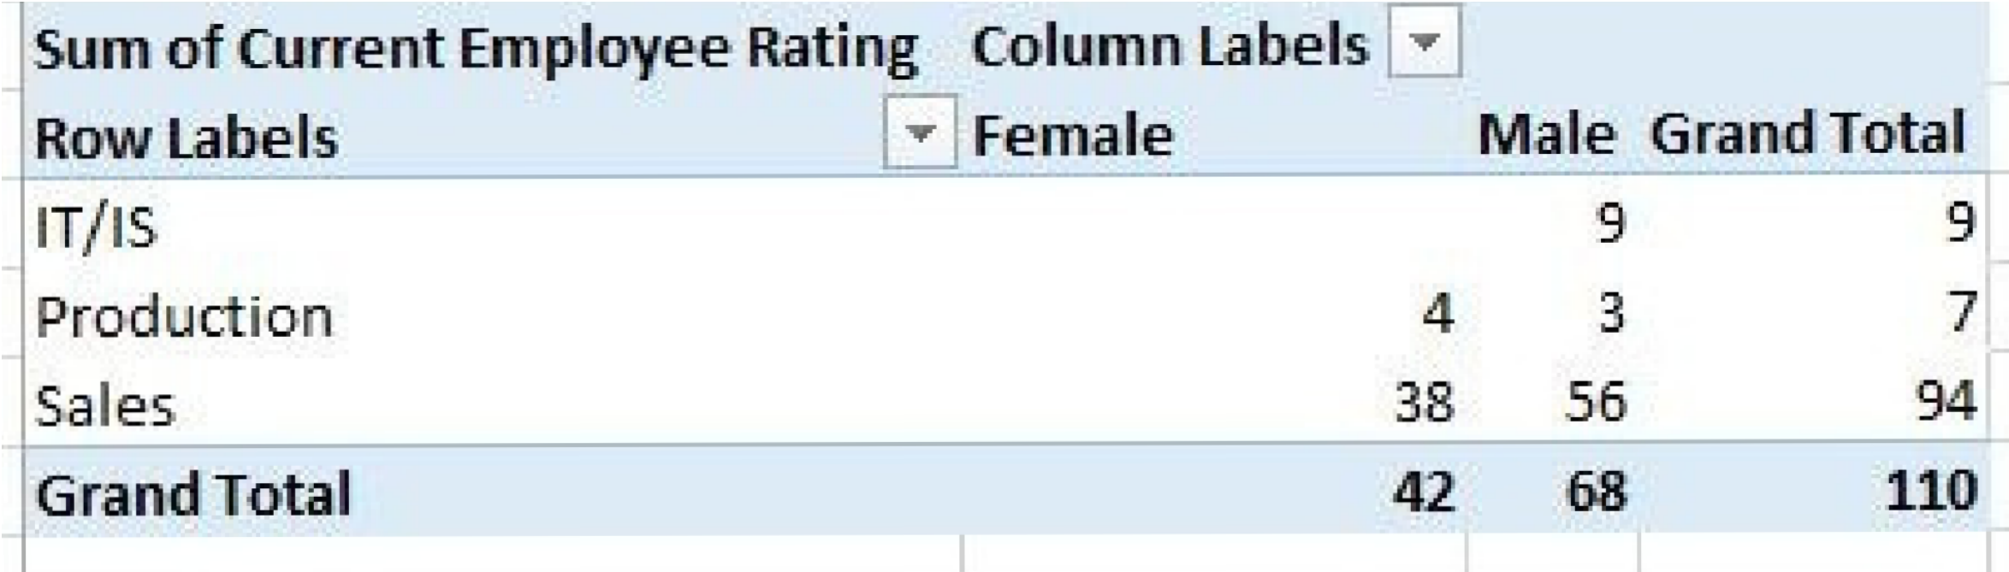
RESULTS 1.TABLE
11

Slide 14

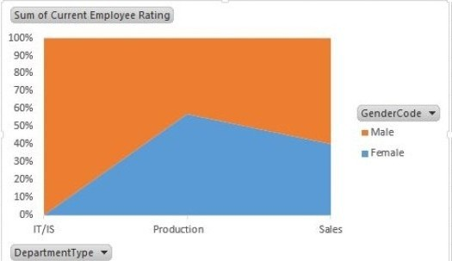
2.BAR DIAGRAM
11

Slide 15
CONCLUSION
The analysis of employee performance highlights important patterns in workplace evaluations. It is essential to consider how gender may influence perceptions and ratings, ensuring that biases do not skew the assessment of performance. By addressing potential disparities and fostering a culture of fairness, organizations can create a more inclusive environment where employee performance is accurately and equitably recognized, allowing all individuals to contribute to their fullest potential

